Slide 1
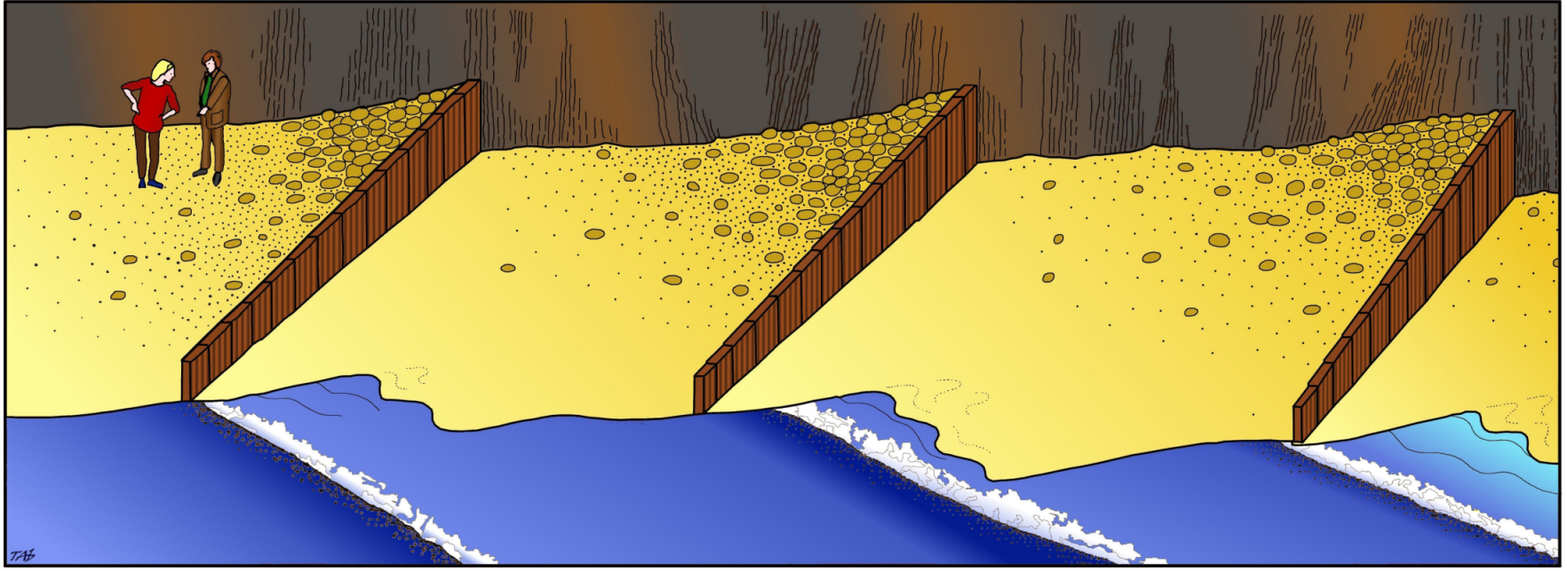
Longshore Drift

Slide 7
Direction of swash

Slide 8
Direction of swash

Slide 9
Direction of swash

Slide 10
Direction of swash

Slide 11
Direction of swash

Slide 12
Direction of swash

Slide 13
Direction of swash

Slide 14
Direction of swash

Slide 15
Direction of swash

Slide 16
Direction of swash

Slide 17
Direction of swash

Slide 18
Direction of swash

Slide 19
Direction of swash

Slide 20
Direction of swash

Slide 21
Direction of swash

Slide 22
Direction of swash
Backwash

Slide 23
Direction of swash
Backwash

Slide 24
Direction of swash
Backwash

Slide 25
Direction of swash
Backwash

Slide 26
Direction of swash
Backwash

Slide 27
Direction of swash
Backwash

Slide 28
Direction of swash
Backwash

Slide 29
Direction of swash
Backwash

Slide 30
Direction of swash
Backwash

Slide 31
Direction of swash
Backwash

Slide 32
Direction of swash
Backwash

Slide 33
Direction of swash
Backwash

Slide 34
Direction of swash
Backwash

Slide 35
Direction of swash
Backwash

Slide 36
Direction of swash
Backwash

Slide 37
Direction of swash
Backwash

Slide 38
Direction of swash
Backwash
Longshore
Drift

Slide 39
Direction of swash
Backwash
Longshore
Drift

Slide 40
Direction of swash
Longshore
Drift

Slide 41
Direction of swash
Longshore
Drift

Slide 42
Direction of swash
Longshore
Drift

Slide 43
Direction of swash
Longshore
Drift

Slide 44
Direction of swash
Longshore
Drift

Slide 45
Direction of swash
Longshore
Drift

Slide 46
Direction of swash
Longshore
Drift

Slide 47
Direction of swash
Longshore
Drift

Slide 48
Direction of swash
Longshore
Drift

Slide 49
Direction of swash
Longshore
Drift

Slide 50
Direction of swash
Longshore
Drift

Slide 51
Direction of swash
Longshore
Drift

Slide 52
Direction of swash
Longshore
Drift

Slide 53
Direction of swash
Longshore
Drift

Slide 54
Direction of swash
Longshore
Drift

Slide 55
Direction of swash
Longshore
Drift

Slide 56
Build up of sediment
against the groyne
Direction of swash
Groyne traps sediment
Longshore
Drift

Slide 57
This powerpoint was kindly donated to www.worldofteaching.com
http://www.worldofteaching.com is home to over a thousand powerpoints submitted by teachers. This is a completely free site and requires no registration. Please visit and I hope it will help in your teaching.

